Slide 1

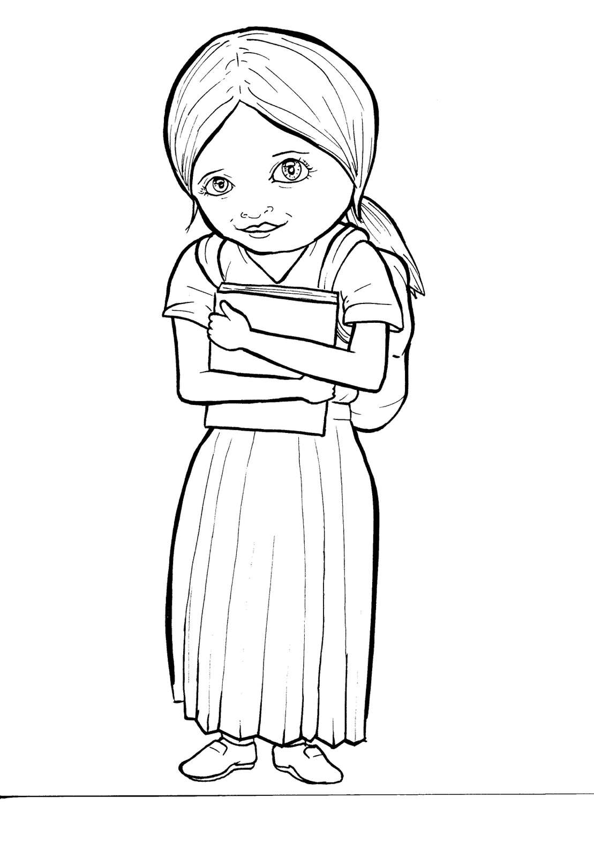
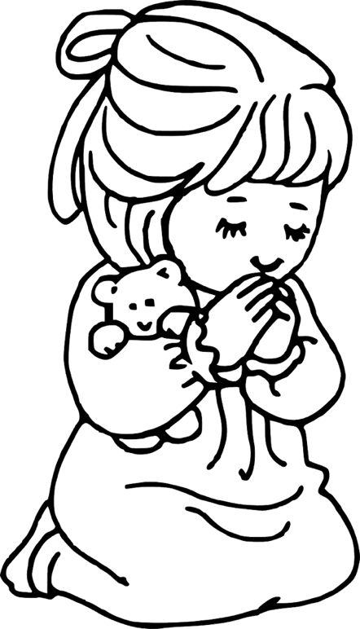
49. Growing as
a Christian
Part 1
Syllable Charts

Slide 2
Words in Syllable Types

Slide 3
Closed – Short Vowel
A closed syllable has one vowel
followed by one or more consonants,
and the vowel is short.
st
o
p
˘

Slide 4
can
-ab-
ask
plant

Slide 5
ef-
-ven
fresh
-pen
-dren
-lent

Slide 6
him
if
sis-
will
chil-
with

Slide 7
prob-
God

Slide 8
up
sun

Slide 9
Open – Long Vowel
An open syllable has one vowel
with no consonant after it,
and the vowel is long.
−
go

Slide 10
he
Je sus
be
e ven
be liever

Slide 11
Bi ble
si lent

Slide 12
go
o pen

Slide 13
my

Slide 14
need y
prob ab ly

Slide 15
Silent e – Long Vowel
A silent e syllable has one vowel,
followed by one consonant
and a silent e at the end.
The vowel is long.
−
ca
e
v

Slide 16
came
takes
share

Slide 17
these

Slide 18
like
shine
life
time

Slide 19
those
close

Slide 20
Vowel Teams – Long Vowel
Many vowel teams follow this rule:
When two vowels get together,
the first one names its letter.
So the first vowel will make its long sound,
and the second vowel is silent.
−
e
a
t

Slide 21
air
rain

Slide 22
day
pray
pray er

Slide 23
be liev ers

Slide 24
see
meet
need y

Slide 25
each
hear
teach es

Slide 26
grow
know

Slide 27
new

Slide 28
cool
too

Slide 29
Vowel Teams – Other Sounds
Sometimes vowel teams make other sounds.
oil

Slide 30
good
book

Slide 31
soil

Slide 32
with out
a bout

Slide 33
call

Slide 34
R - Controlled
R-controlled syllables have one or more vowels
followed by an “r.”
The “r” changes the sound of the vowel.
o
r
ange

Slide 35
start
Mark

Slide 36
believ ers
sis ters
teach ers

Slide 37
hurts
church

Slide 38
or
for
short

Slide 39
ef fort

Slide 40
Consonant – l-e
When you see consonant l-e at the end of a word,
count back three.
The “l-e” makes the /–le/ sound.
pur
p
l
e

Slide 41
Bi ble

Slide 42

Other Sounds – -nk/-ng
The “-nk” and “-ng”
change the sound of the vowel.
bank
thing

Slide 43
believ ing
grow ing

Slide 44

Other Sounds – schwa
The schwa syllable has an “a” that sounds
like the /u/ in banana.
The banana is even shaped like a short u.
ba nan a

Slide 45
a bout

